Slide 1
DENTON CREEK ELEMENTARY
Home of the
TRAILBLAZERS!!

Slide 2
Welcome to another outstanding year at DCE!
Denton Creek continues to be a Title 1 campus for the 2016-2017 school year. The purpose of Title 1, Part A is:
“… to ensure that all children, particularly low-achieving children in the highest poverty schools, have a fair, equal, and significant opportunity to obtain a high-quality education, and reach, at a minimum, proficiency on challenging state academic achievement standards and state academic assessments.”
Our Title 1 Compact Letter went home on Monday. Please sign and return the Compact Letter to your child’s teacher no later than September 2, 2016. The Compact Letter will also be reviewed during Fall Conferences.

Slide 3
Denton Creek is proud to be a school where 100% of our educators and paraprofessionals are Highly Qualified!
To learn more about Title 1 and ways to partner with DCE, please plan on attending the
“Title 1 Parent Informational Meeting”
Wednesday, September 7th
7:30am in the DCE library.
It is going to be an AMAZING year!
Shannon Edwards
Principal, Denton Creek Elementary

Slide 4
Denton Creek is proud to be a school where 100% of our educators and paraprofessionals are Highly Qualified!
It is going to be an AMAZING year as we all work together as One Team with Endless Possibilities!
Shannon Edwards

Slide 5
Class Schedule
8:00 – 9:30 Class 1: 5A-Science, 5B-Math, 5C LA/Social St.
9:30 – 10:35 Class 2: 5A-LA/Social St., 5B-Science, 5C-Math
10:35 – 11:30 Specials (Friday 11:10-12:00)
11:30 – 12:00 Class 2: Continued
12:00 – 12:40 Homeroom/Guidance/Library/Class meetings
Begin Class 3
12:45-1:15 – Lunch
1:15 – 1:45 – Recess
1:50 – Class 3: 5A-Math, 5B-LA/Social St., 5C-Science
2:55 – Bus Bell
3:05 – Dismissal Bell

Slide 6
Special Events
A background check is needed to help with ANY activity at school!
9/30 Special Friends Day
10/3-5 Sky Ranch (Mon-Wed)
10/28 Pumpkin Math with 2nd Grade
11/21-25 Thanksgiving Holiday
12/8 Holiday Play
12/15 Winter Holiday Party
2/14 Valentine Party
3/9 Open House
3/13-17 Spring Break
Talent Show – Last week (optional)
5th Party – Aquatic Center- Last week
5th Grade Graduation – Last week

Slide 7
Behavior Management
Trailblazer Expectations – Expectations of school conduct and respect
Trailblazer Life Principles
Positive Reinforcement
Logical Consequences
Conference with teacher
Stop and Think forms – require parent signature
Phone Call home

Slide 8
5th Grade Discipline Plan
The 5th grade discipline plan is based on our Trailblazer Expectations and the Love and Logic philosophy we promote at Denton Creek. Our goals are to build positive relationships with our learners, share control in decision making, and use logical consequences related to their actions. We hope to help them grow from their mistakes and become responsible, confident adults.
Each case will be handled individually, and the learners will be involved in finding the appropriate consequence for their actions. If more encouragement is needed, they will be asked to reflect by completing a Stop and Think form and have it signed by their parent. With more serious situations, the teachers will notify their parents by phone.
Please contact us at any time for clarification or with situations we may not be aware of. Thank you for your support.

Slide 9
Classwork & Homework
DCE 5th Website - http://dentoncreek5thgrade.weebly.com/
Planners, Red/Green Folders, Friday Folders
Digital Portfolios
Make up work – Have same number of days to make up work as missed days
Report Cards - every 9 weeks.
Progress Reports – mid way through 9 weeks if in danger of failing.
5th STAAR Tests – 3/28 Math , 3/29 Reading,
5/10 Science

Slide 10
Attendance
Morning Drop Off – Gym doors open at 7:30 am/Breakfast available
Students are counted tardy after 7:50 am
Dismissal is at 3:05 pm. Please be prompt!
Please send in a written note if your child has been absent.
School Attendance is important. Please help install that in our students.
Please contact the teacher by 12:00pm about dismissal changes. Contact the office if there is an emergency.

Slide 11
Why iPads in CISD?
We believe that technology has the power to transform the classroom!
The iPad is transforming the ways that we teach and learn. It enables endless opportunities to create hands-on, customizable learning experiences. With just a few taps, we can customize the iPad with materials that fit our learners’ levels and learning styles. We can teach all of our learners the same lesson and content - in different ways tailored to individual learners’ needs.

Slide 12
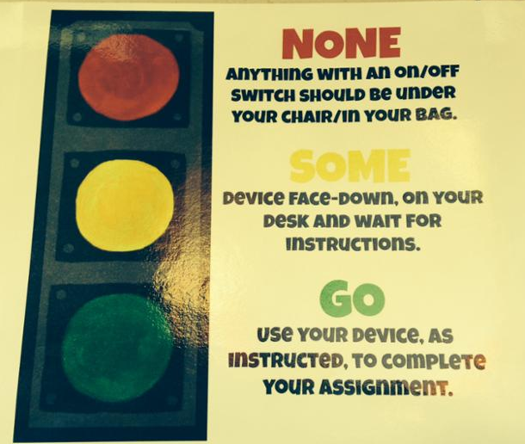
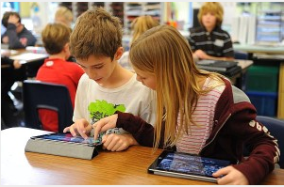
Safeguards -
Classroom Management in a Digital World
Notes:
DIscuss Classroom Management procedures with iPads here. What are your class norms? How do you keep learners safe when using digital tools?

Slide 13
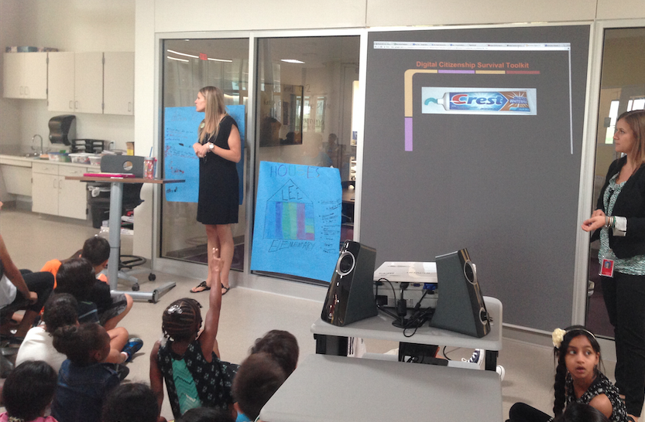
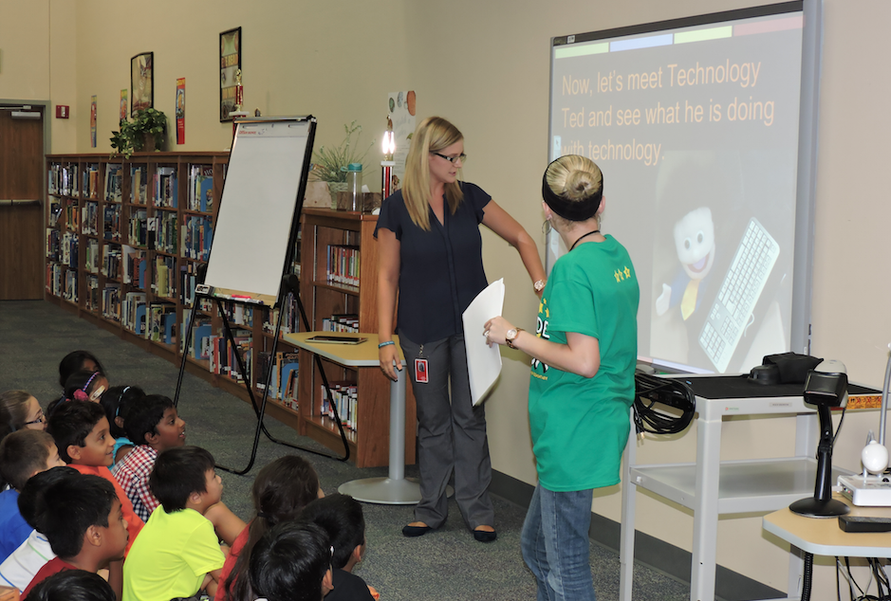
Safeguards - Digital Literacy Courses
...for our learners
Notes:
To keep our learners safe, ALL LEARNERS go through
CISD has designed specific training for all learners and educators
All learners had to have digital citizenship lessons before technology could even be placed in their hands.
This aligned overview is covered district wide
Learners signed a pledge promising to follow the Responsible Use Policy
They are continuously reminded about their digital footprint (what is put out there stays out there)

Slide 14
Safeguards - Information Literacy Course
...for our educators
Notes:
IN addition, all EDUCATORS go through Information Literacy training which includes...
How do we safe search
How do we find reliable research
How do we find information based on reading level

Slide 15
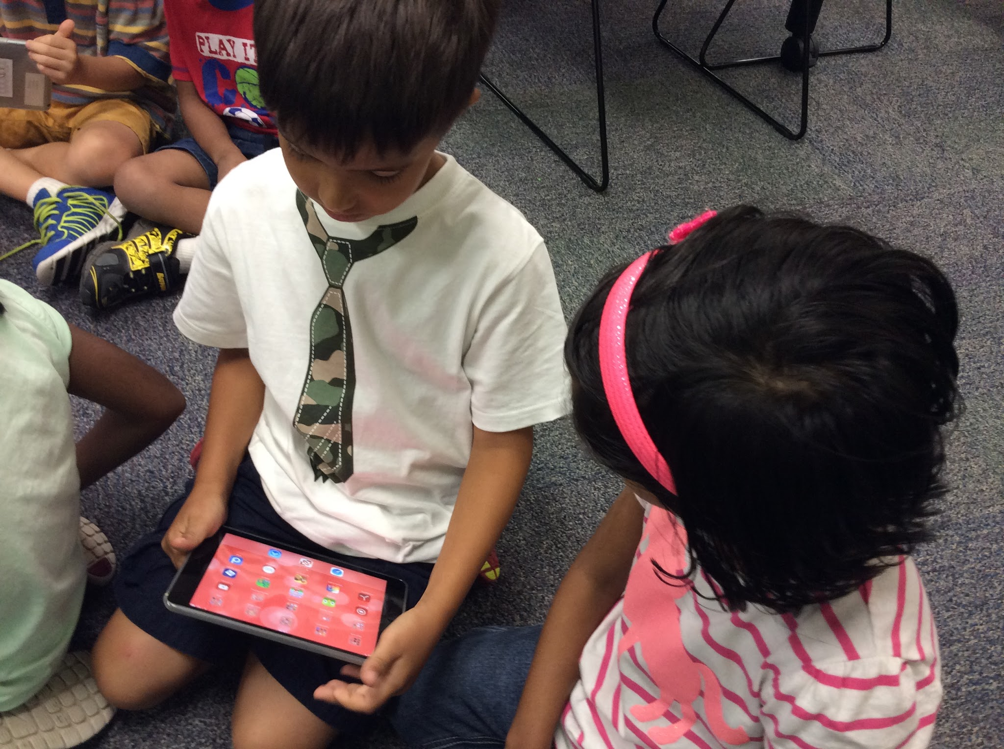
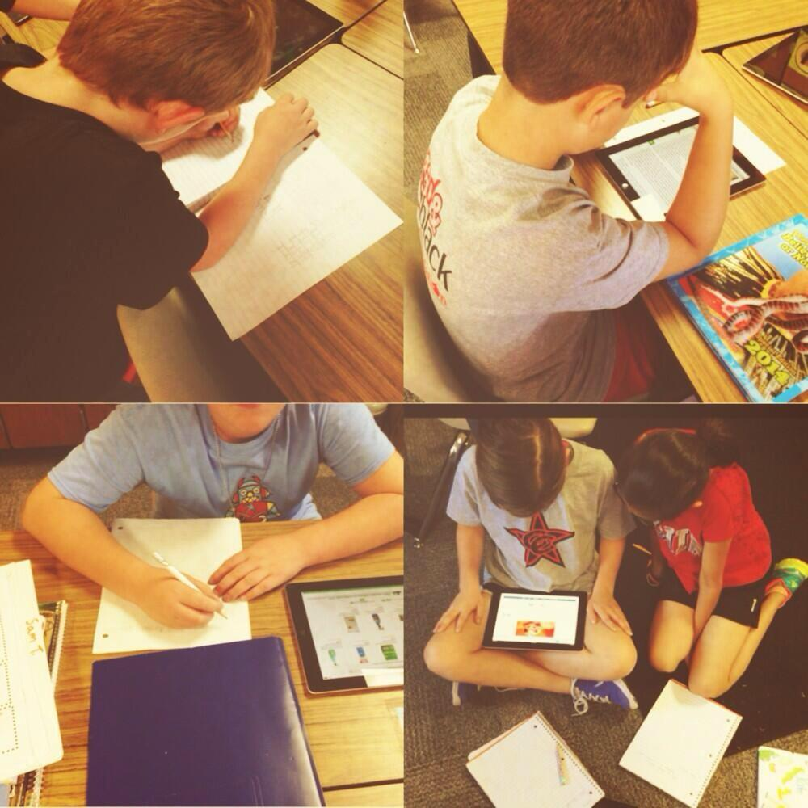
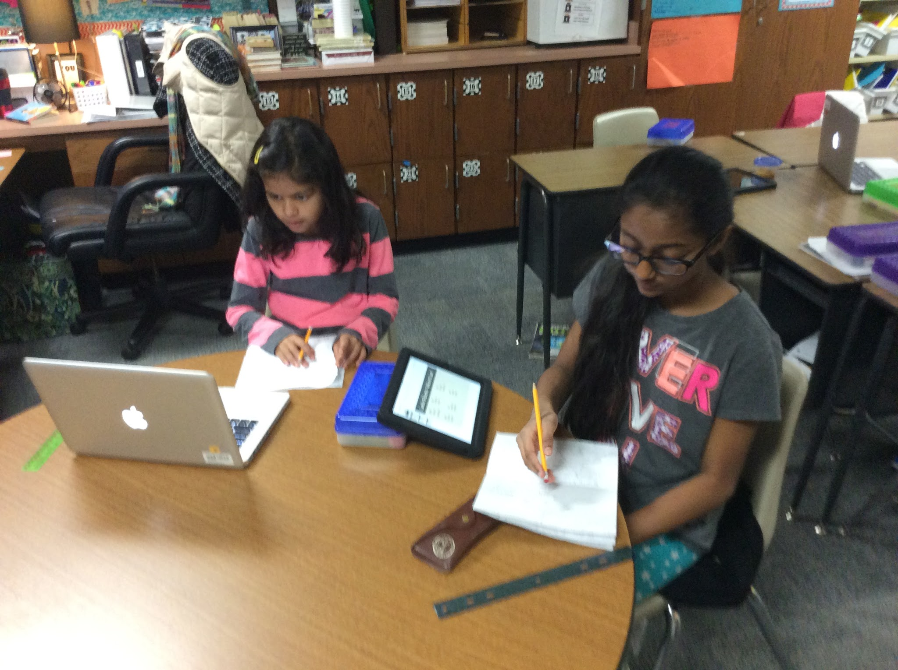
Collaboration...Choice…
Workflow
Notes:
Talk about examples of how you use the iPads. For ex: screencasting their thinking, accessing menus and having open lines of feedback possibilities between educator and learner,
discuss collaboration, not only using iPads
Various devices being used. Gives another channel for interaction, but doesn’t replace face to face. Learners are discussing while using devices. Multi-modal.
choice in activity, choice in how they work (together, independently, etc.)
not all ipad all the time
just because they have access to device does not mean all the thinking happens digitally.

Slide 16
Parents...Part of the Process
The Apple ID Process has changed for the 2016/2017 school year.
Parents WILL not have to fill out any information online. CISD will be working with Apple to create these Apple IDs for each learner, in full compliance with FERPA and COPPA standards.
This Apple ID is known as a Managed Apple ID.
More information can be found at: http://www.apple.com/education
Notes:
FERPA - Family educational rights and privacy act
COPPA - Children’s Online privacy protection act

Slide 17
Communication
Best Way: EMAIL
kstruck@coppellisd.com
lfaundez@coppellisd.com
joakes@coppellisd.com
gagonzalez@coppellisd.com
mleon@coppellisd.com
Phones:
Struck 214.496.8158
Faundez 214.496.8152
Oakes 214.496.8127
Holliday 214.496.8120
Leon 214.496.8145

Slide 18
A Day in Math
Problem of the Day – 5 min. warm-up
Mini-Lesson on a specific skill
Guided Practice with small groups
Game/activity to reinforce the skill
Math Menu – Application to real world
Learners select products from a menu where they are
allowed the opportunity for choice and voice. Usually
stored on Blendspace.

Slide 19
Math Resources
Go Math! – Class book/online book & activities
My Weebly page – Blendspace & Math Menus
Ten Marks – Online HW
Math Apps/Websites – selected by the teachers to practice skills and fluency

Slide 20
Thank You for Coming!!
We appreciate everything you do!!

